Slide 1
some enhancements on simple link list

Slide 2
Appending data
Appending data in a link list is quite a time consuming process as opposed to appending data in an array.
how to make appending efficient in link list
lets have another class member pointer “tail” in addition to the “head”
tail pointer should point to the last node in the link list.
lets see how this will make appending efficient.

Slide 3
modified class definition
class List
{
private:
struct nodeType {
float info;
nodeType *link;
};
nodeType *head;
nodeType *tail;
int count; //no of nodes in List
public:
. . .
}

Slide 4
Visual Representation head and tail can also be named as first and last
If there is only one node, then both pointers point to it

Slide 5
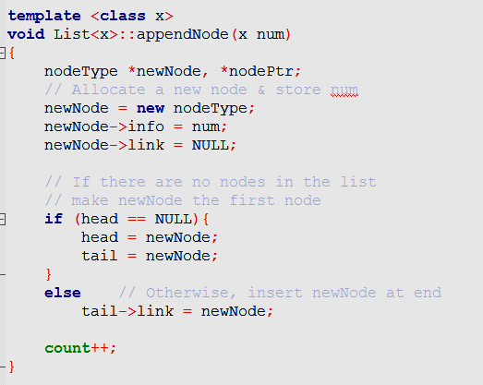
modification we have to do in the link list class
Append function
tail = newNode;

Slide 6
Doubly Link List

Slide 7
Doubly Link List
in a doubly link list, we have two pointers in the struct nodeType
struct nodeType {
float info;
nodeType *next;
nodeType *prev;
}

Slide 8
Benefit of Doubly link list
link list can be traversed in either direction
insertion and deletion becomes easy

